Slide 1
To work on issue of under-predicting house prices via linear regression above $320,000
Mohammad Sufyan

Slide 2
Project OVERVIEW
Exploratory Data Analysis
Identify key features , pairwise relationships
Linear regression and Feature engineering
Interaction terms
Lasso Regression
Optimise coefficients , Optimise ordinal features, Minimize Outliers
Key Takeaways and Future work ahead

Slide 3
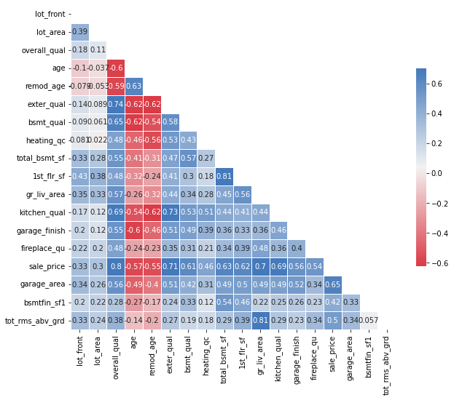
Heatmap on correlation to sale price
Features identified
Generally the bigger the area the higher the price
Ordinal categories with strong correlation with Sale Price
(Quality and conditions)
Notably strong correlations
Overall quality +ve correlation (+0.8)
Age of buildings –ve correlation generally with all features
(-0.55 with sale price)

Slide 4
Pairwise relationships
Feature 1 | Feature 2 | Pair Correlation | Feature 1 & Sales Correlation | Feature 2 & Sales Correlation
garag_cars | garage_area | 0.889558 | 0.648128 | 0.650246
gr_liv_area | tot_rms_abv_grd | 0.808174 | 0.697038 | 0.504014
total_bsmt_sf | 1st_flr_sf | 0.798801 | 0.629303 | 0.618486
bedroom_abv_gr | tot_rms_abv_grd | 0.673442 | 0.137067 | 0.504014
2nd_flr_sf | gr_liv_area | 0.654530 | 0.248452 | 0.697038
bsmtfin_sf1 | bsmt_full_bath | 0.640606 | 0.423856 | 0.283332
gr_liv_area | full_bath | 0.629736 | 0.697038 | 0.537969
2nd_flr_sf | half_bath | 0.611432 | 0.248452 | 0.283001
overall_qual | garag_cars | 0.598912 | 0.800207 | 0.648128
2nd_flr_sf | tot_rms_abv_grd | 0.584059 | 0.248452 | 0.504014
Identifying groups of highly correlated features only – keeping one of them so that the model can have much predictive power with lesser features

Slide 5
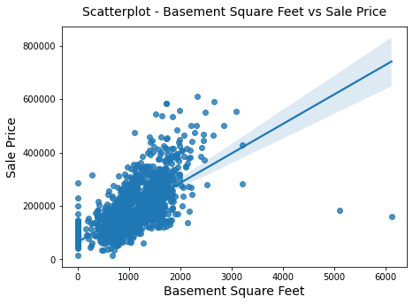
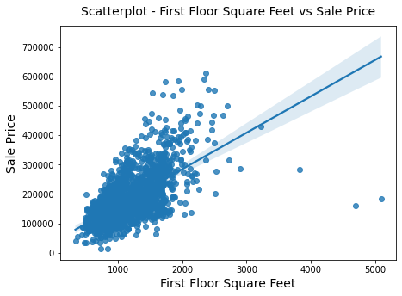
Pairwise relationships
Feature 1 | Feature 2 | Pair Correlation | Feature 1 & Sales Correlation | Feature 2 & Sales Correlation
garag_cars | garage_area | 0.889558 | 0.648128 | 0.650246
gr_liv_area | tot_rms_abv_grd | 0.808174 | 0.697038 | 0.504014
total_bsmt_sf | 1st_flr_sf | 0.798801 | 0.629303 | 0.618486
bedroom_abv_gr | tot_rms_abv_grd | 0.673442 | 0.137067 | 0.504014
2nd_flr_sf | gr_liv_area | 0.654530 | 0.248452 | 0.697038
bsmtfin_sf1 | bsmt_full_bath | 0.640606 | 0.423856 | 0.283332
gr_liv_area | full_bath | 0.629736 | 0.697038 | 0.537969
2nd_flr_sf | half_bath | 0.611432 | 0.248452 | 0.283001
overall_qual | garag_cars | 0.598912 | 0.800207 | 0.648128
2nd_flr_sf | tot_rms_abv_grd | 0.584059 | 0.248452 | 0.504014
High correlation to each other

Slide 6
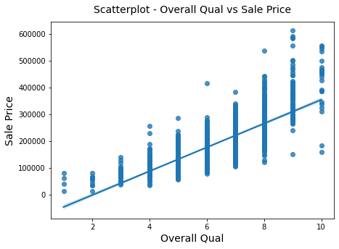
Pairwise relationships
Feature 1 | Feature 2 | Pair Correlation | Feature 1 & Sales Correlation | Feature 2 & Sales Correlation
garag_cars | garage_area | 0.889558 | 0.648128 | 0.650246
gr_liv_area | tot_rms_abv_grd | 0.808174 | 0.697038 | 0.504014
total_bsmt_sf | 1st_flr_sf | 0.798801 | 0.629303 | 0.618486
bedroom_abv_gr | tot_rms_abv_grd | 0.673442 | 0.137067 | 0.504014
2nd_flr_sf | gr_liv_area | 0.654530 | 0.248452 | 0.697038
bsmtfin_sf1 | bsmt_full_bath | 0.640606 | 0.423856 | 0.283332
gr_liv_area | full_bath | 0.629736 | 0.697038 | 0.537969
2nd_flr_sf | half_bath | 0.611432 | 0.248452 | 0.283001
overall_qual | garag_cars | 0.598912 | 0.800207 | 0.648128
2nd_flr_sf | tot_rms_abv_grd | 0.584059 | 0.248452 | 0.504014

Slide 7
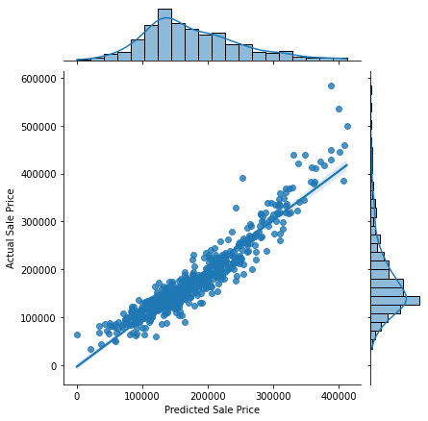
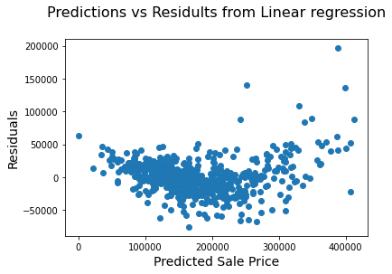
Linear regression model
Underfitted, with higher bias at the top above
Noted after $320,000, higher residuals observed
Current RMSE: 26149

Slide 8
Linear regression model
Observation:
This indicates under-prediction of housing prices (Residual of $200,000!)
Hypothesis:
We are missing the X-factor that helps bring up these assets to its true potential

Slide 9
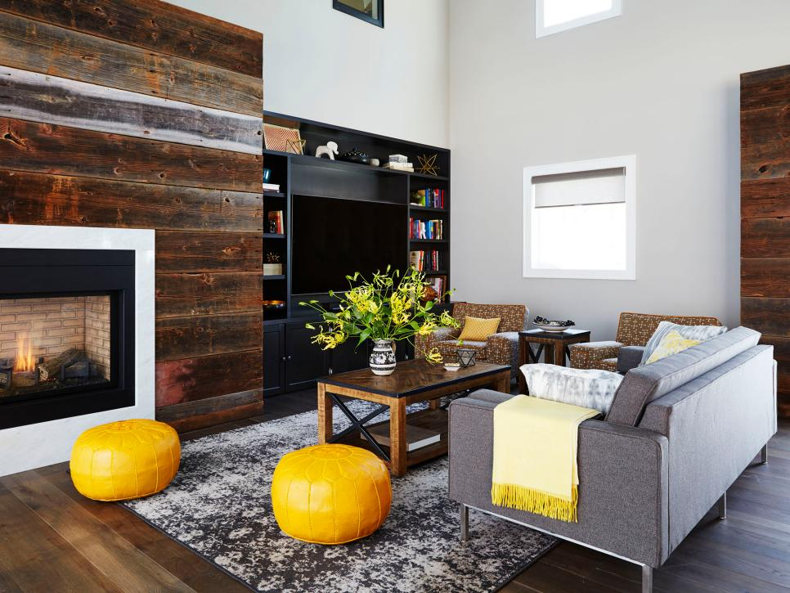
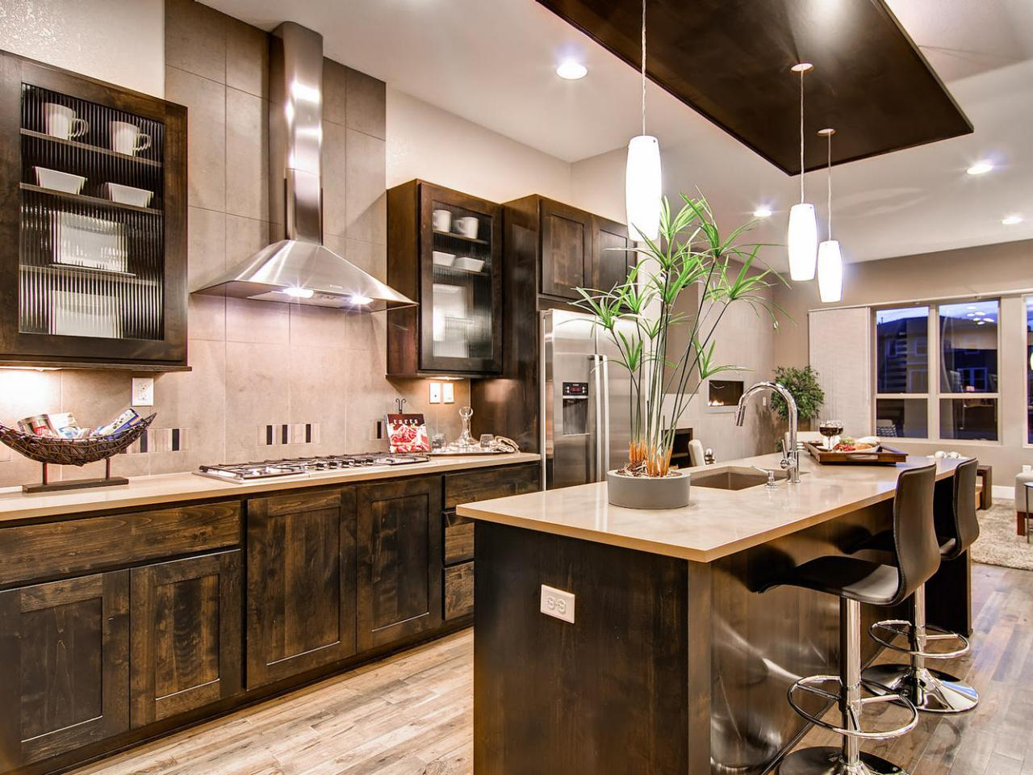
imagine viewing…
Fireplace
Kitchen Quality

Slide 10
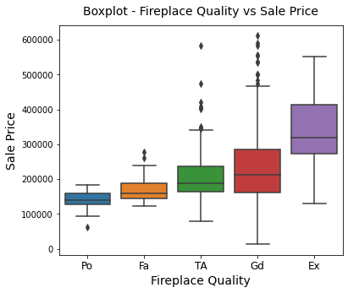
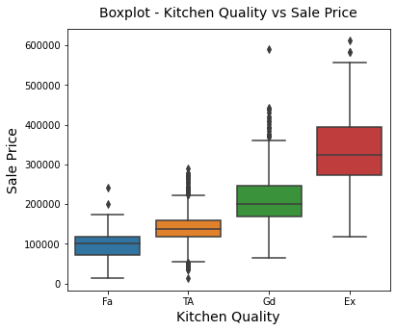
Looking at their correlation independently
Fireplace
Kitchen Quality

Slide 11
In the real world, we see it as a whole
Fireplace
How big the living space is?
How grand it looks overall
Interacting with one another
Kitchen Quality

Slide 12
In the real world, we see it as a whole
Fireplace
NOT ACCOUNTED IN MODEL
Hence, we multiply these together to have an amplified effect of these features together
Interacting with one another
Kitchen Quality

Slide 13
Featuring engineering – interaction terms
Combinations | Combination correlation to Sale price | Feature 1 | Feature 2 | F1_Sales | F2_Sales | Percentage increase from independent features
[overall_qual, gr_liv_area] | 0.837152 | overall_qual | gr_liv_area | 0.800207 | 0.697038 | 11.825650
[overall_qual, garag_cars] | 0.820239 | overall_qual | garag_cars | 0.800207 | 0.648128 | 13.266413
[overall_qual, garage_area] | 0.813508 | overall_qual | garage_area | 0.800207 | 0.650246 | 12.172869
[overall_qual, tot_rms_abv_grd] | 0.795420 | overall_qual | tot_rms_abv_grd | 0.800207 | 0.504014 | 21.976263
[gr_liv_area, garag_cars] | 0.793317 | gr_liv_area | garag_cars | 0.697038 | 0.648128 | 17.950677
[overall_qual, 1st_flr_sf] | 0.792151 | overall_qual | 1st_flr_sf | 0.800207 | 0.618486 | 11.673312
[overall_qual, total_bsmt_sf] | 0.768630 | overall_qual | total_bsmt_sf | 0.800207 | 0.629303 | 7.537502
Model takes in interaction terms
Quality
Square Feet Area
Condition

Slide 14
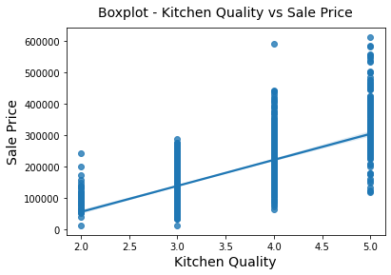
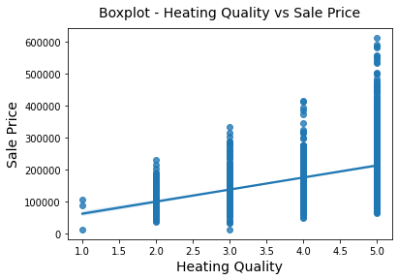
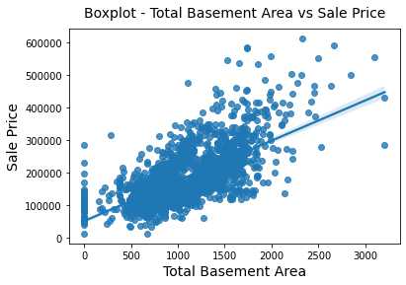
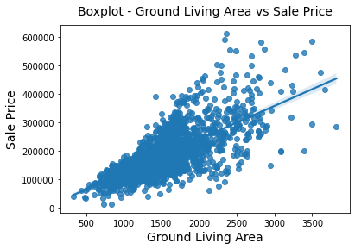
Featuring engineering – interaction terms
Model takes in interaction terms
Quality
Square Feet Area
Condition

Slide 15
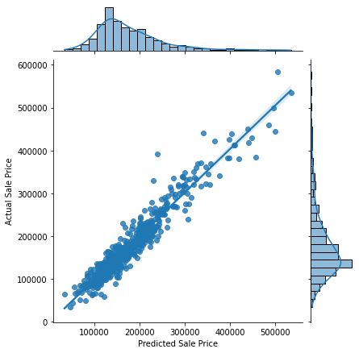
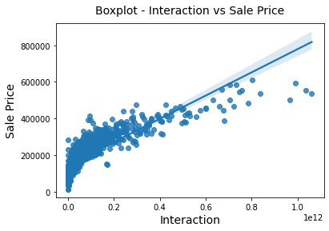
Interaction terms
Current RMSE: 21376, -18.76%
Highly correlated to price
High in magnitude
Improved RMSE by 18.7%
No more skewing upwards when predicting higher sale price
Noted still high bias
Need more variables

Slide 16
Lasso regularization
Model | Changes done | Comments | RMSE | RMSE % Change
Linear regression | Added more features, including All Ordinal ranked sequentially Nominal features | Variance and bias too large for large coefficients and number of variables Need loss function to penalize each variable | 272751033127647.7 | NA
Lasso Regression | Alpha used: 577 | Most coefficients are zeroed out | 19517 | -7.87%
Lasso Regression | Remove zeroed features: 183 → 79 Alpha used: 171 | Most coefficients are zeroed out | 19497 | -0.1%
Lasso Regression | Optimized ordinal features As not all ordinal features are strongly related and should not be ranked. Changed to nominal instead | Outliers removed More linear with lesser variance | 18519 | -5%

Slide 17
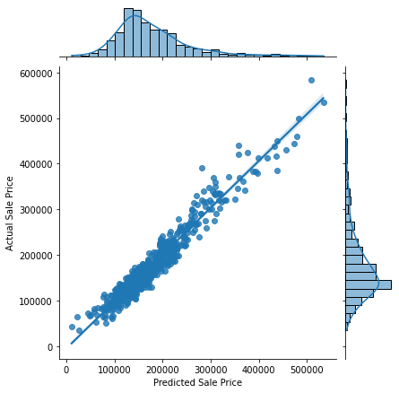
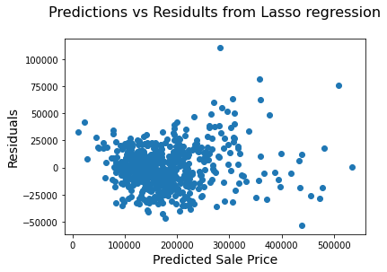
Final - lasso regression

Slide 18
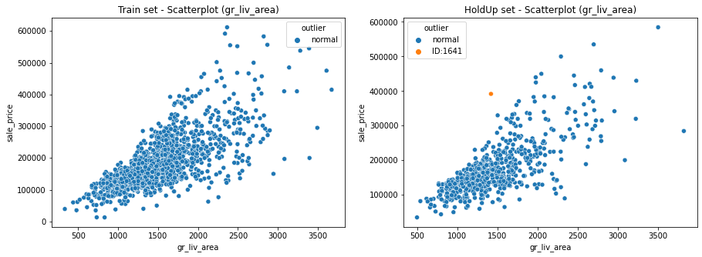
Outliers removed
Behaviour of this outlier found in holdup not consistent in Train set hence removed

Slide 19
Thank you
Key takeaways
Future work ahead
Not all ordinal categories should be given sequential scoring, else unnecessary amplication can ruin predictions
Understanding interaction terms in consumer’s POV and help provide better predictive power
Explore deeper EDA on each ordinal categories
considering doing interaction or putting a score to it instead of nominal categories that kills it with 1s and 0s
Can explore rare variables and filter it off from model

